Slide 1
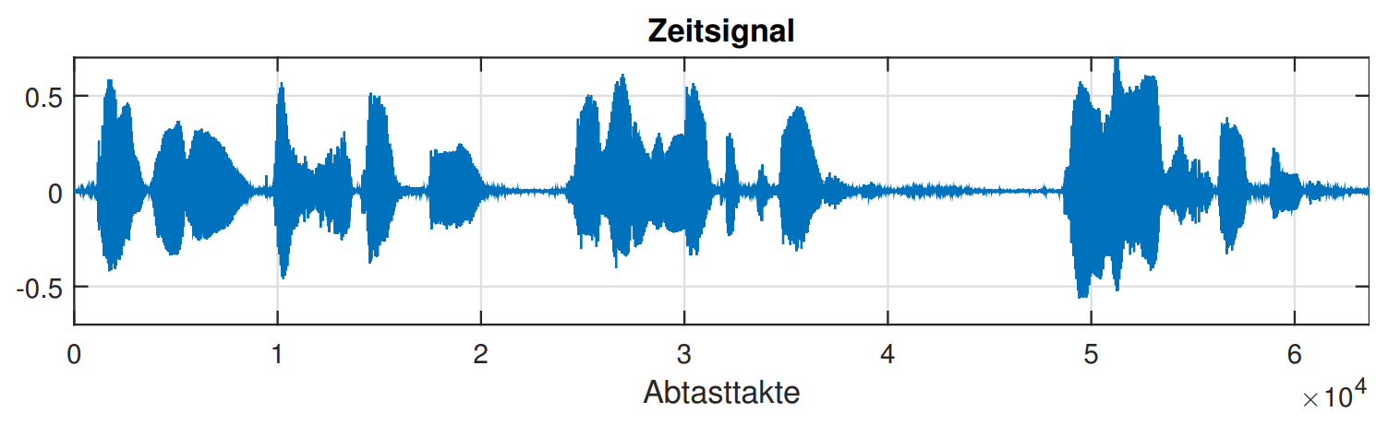
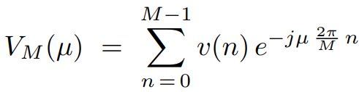
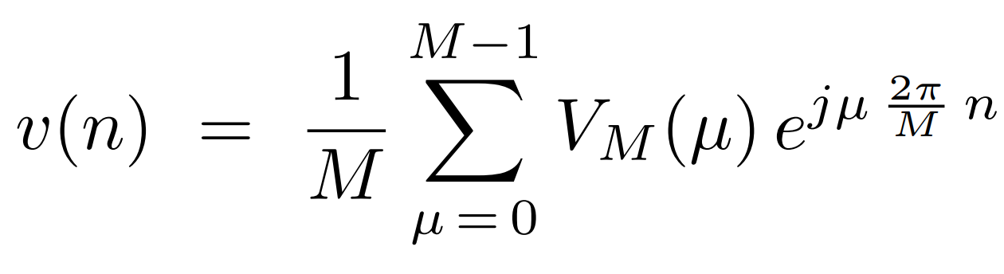
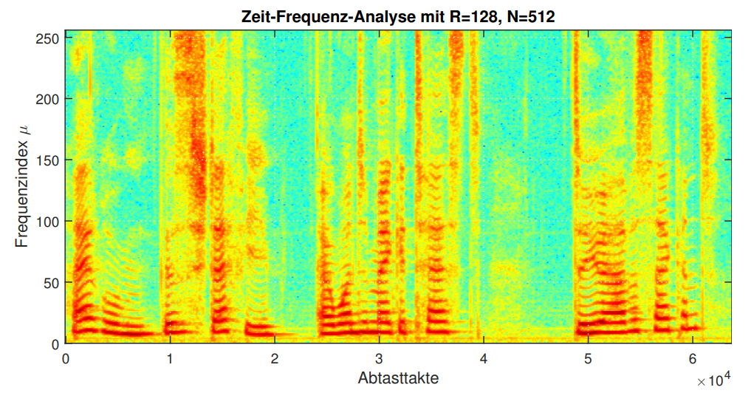
Handout: Topic XYZ
Motivation
Problem
  Recorded audio signal provides samples in the time domain
  Frequency components not directly accessible
  Idea: speaker identification based on spectral components
Concepts
Discrete Fourier Transform
  Calculate discrete frequency bins
    Multiplication with complex exponentials
    Sum over DFT-length
Inverse DFT
  Calculate discrete time samples
    Complex conjugate of exponential factors
    Sum and normalization scaling
DFT
IDFT
Results
Time-frequency Analysis
  Analyze frequency components for moving time windows
    Generation of spectrogram plots
Speech Analysis
  Live visualization of spectral components
    Differentiate speakers based on pitch frequency
References
Hänsler, E., & Schmidt, G. (2005). Acoustic echo and noise control: a practical approach. John Wiley & Sons.
Hayes, M. H. (1996). Statistical digital signal processing and modeling. John Wiley & Sons.
Oppenheim, A. V. (1999). Discrete-time signal processing. Pearson Education.
Proakis, J. G., & Manolakis, D. G. (2013). Digital signal processing: Pearson new international edition. Pearson Higher Ed.
Author: Jane Doe, Date: 30.01.2026

